Slide 1

Intelligent Academic Planner
Daria Cook, Krystal Elliott, Xiaoyu Zhou
December 2, 2016

Slide 2

User & System Requirement Changes
No change to our system or user requirements
We had plans to include a “mapping system”
Due to an increase in scope, this feature was eliminated

Slide 3
Architectural Design & Alternatives
Layered Architectural:
Web Application
Watson APIs are independent
Cloud computing
Client and Server model
Store in our own database in the feature
Alternatives:
Client and Server
Notes:
Layered Architectural: building basic extendable structure in order to add more features
Client to Server: only to make it work

Slide 4
Potential Technical Challenge
Optimize data structure
Optimize NLP algorithms
Correctly formatting the question
Monitor and Control of conversation session
Notes:
1.What is the best data structure to help the answer accuracy
2.In which way we can make question and answer more human and valuable
3.In which way we can track question flows form users and collect userful information in a efficient way

Slide 5
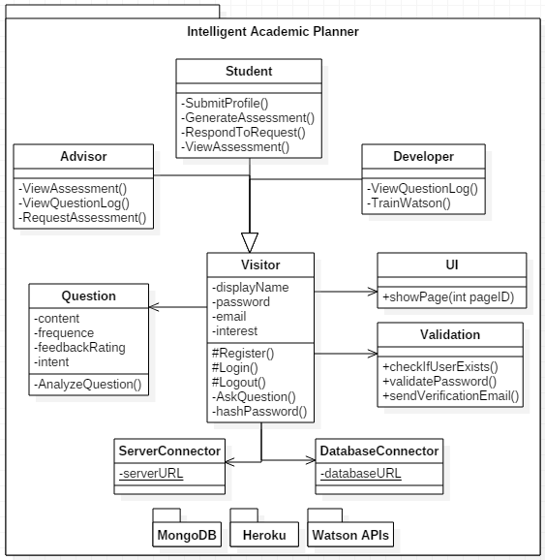
Structural Design:
Class Diagram

Slide 6
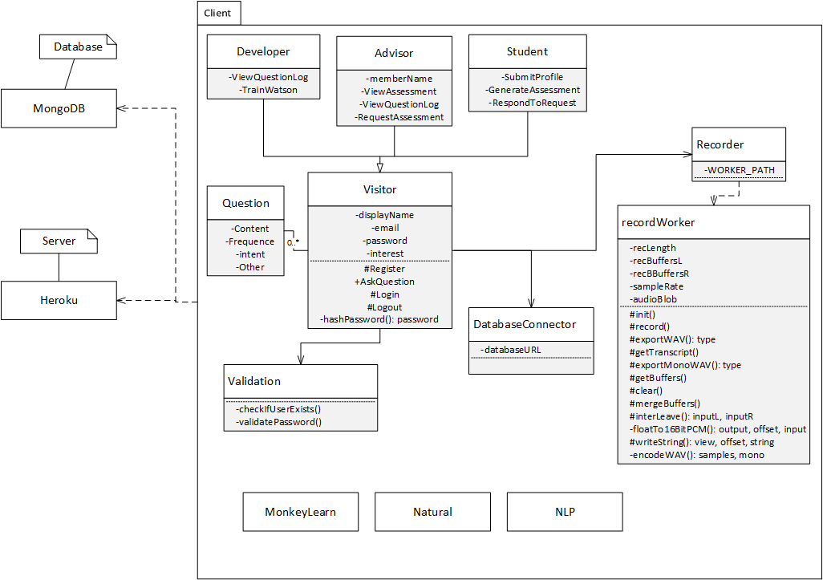
Structural Design Alternative

Slide 7
UI Design & Alternatives

Slide 8
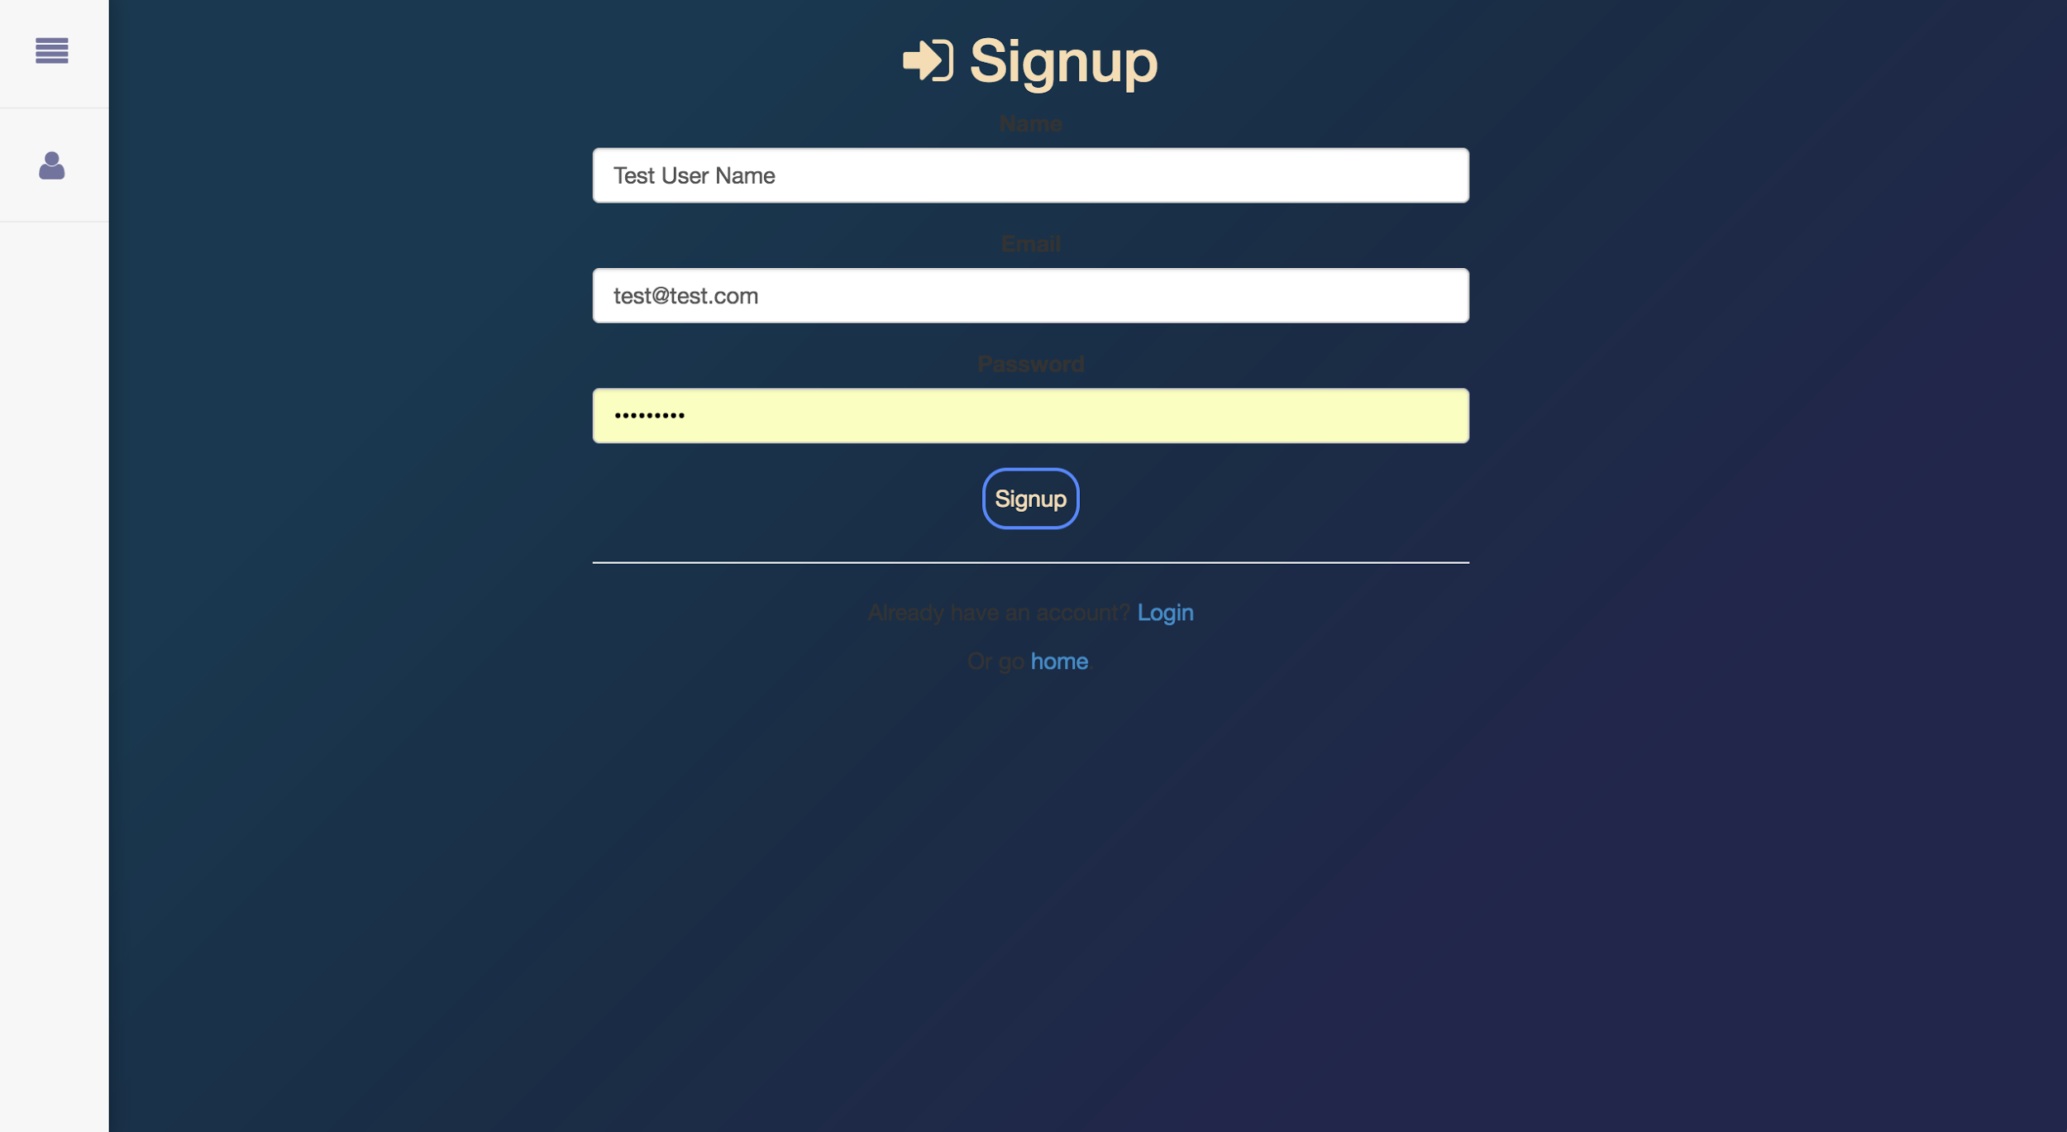
Original Registration

Slide 9
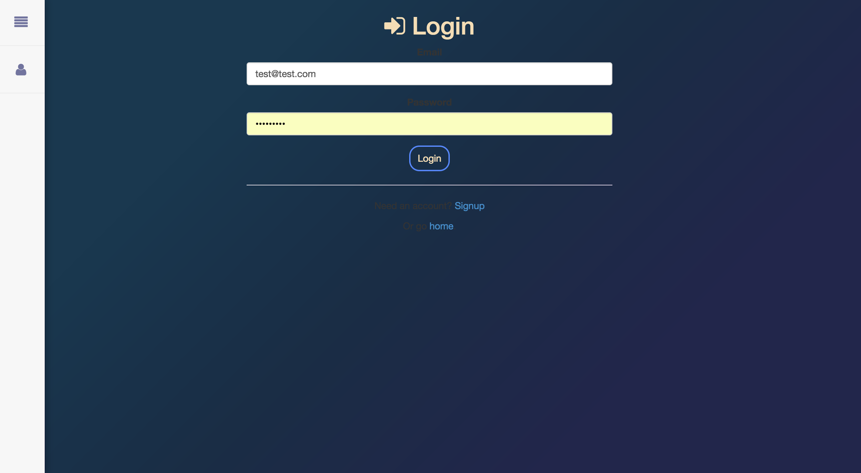
Original Login

Slide 10
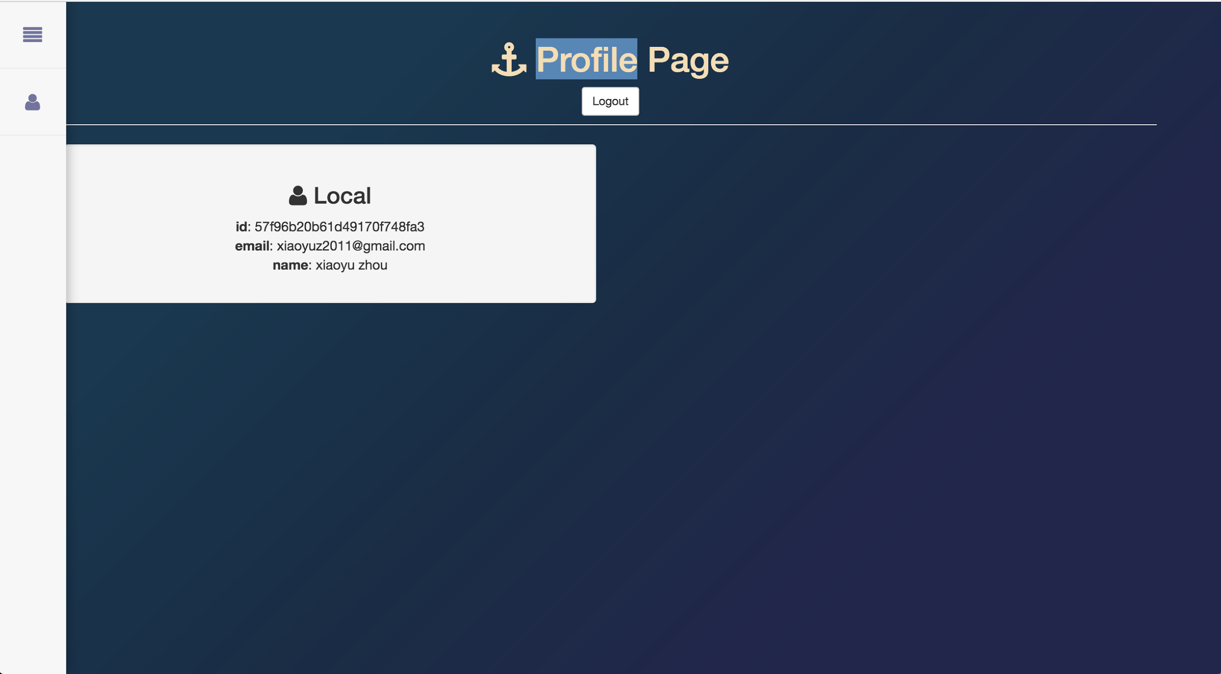
Original Profile Page

Slide 11

Original Search

Slide 12
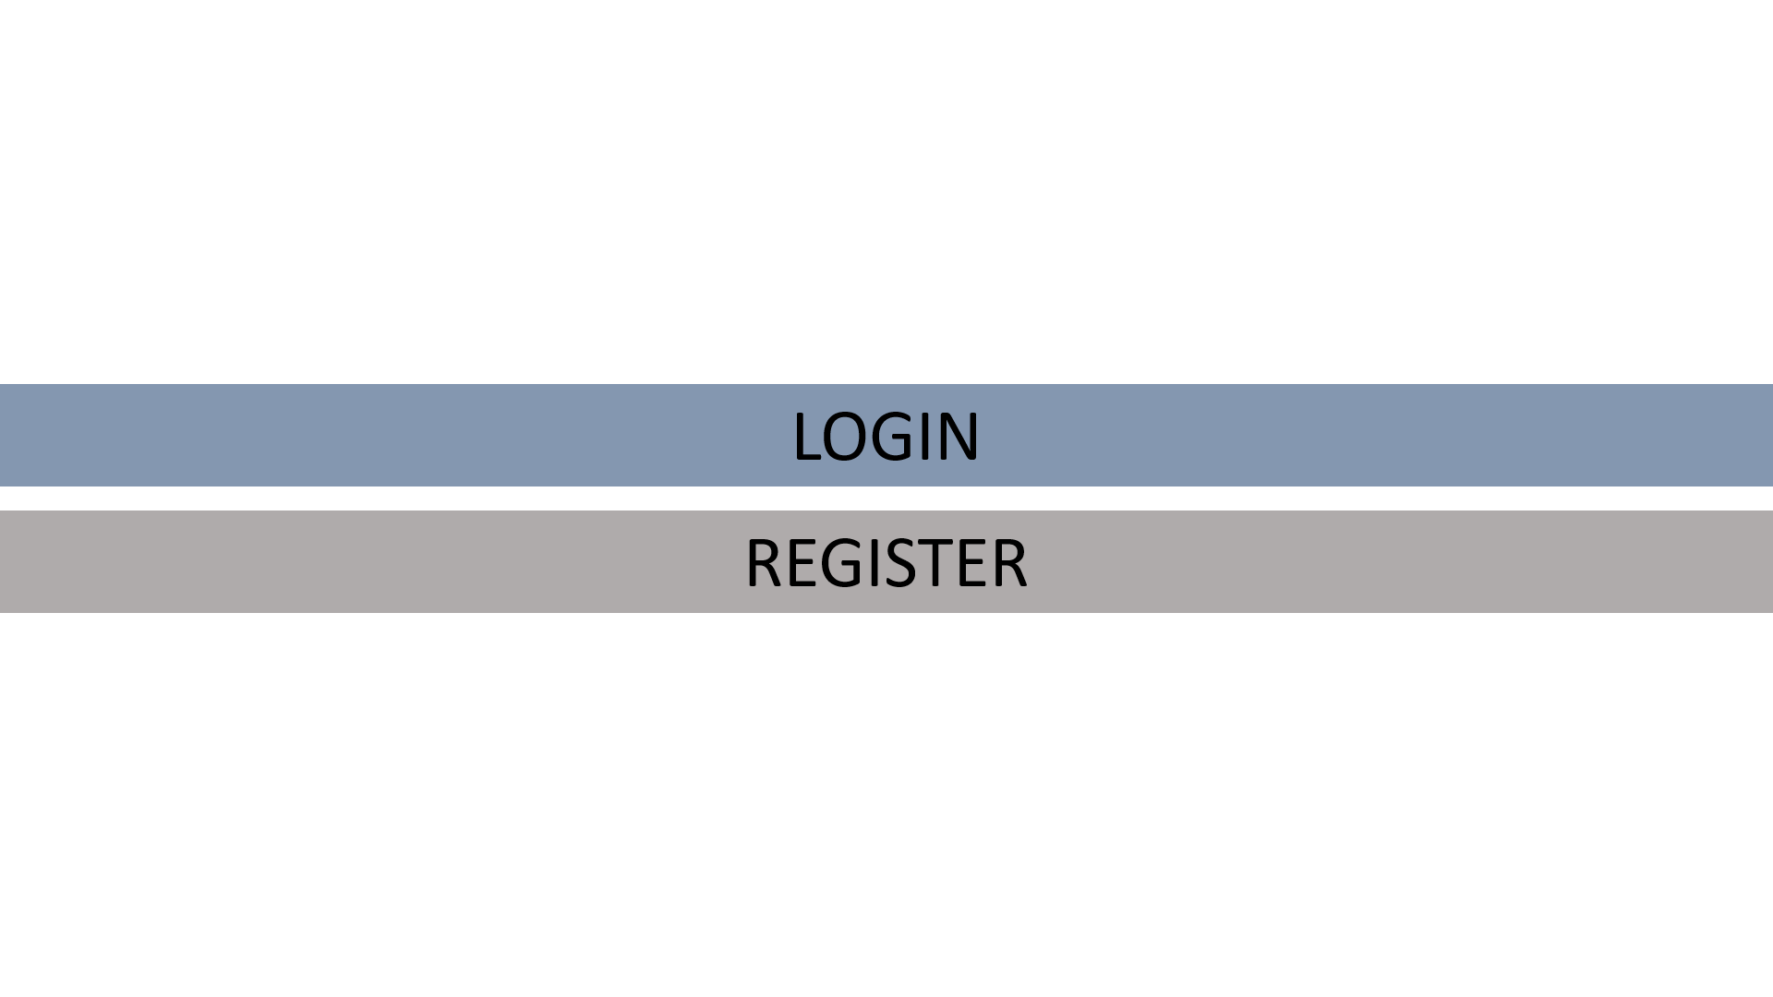
Landing

Slide 13
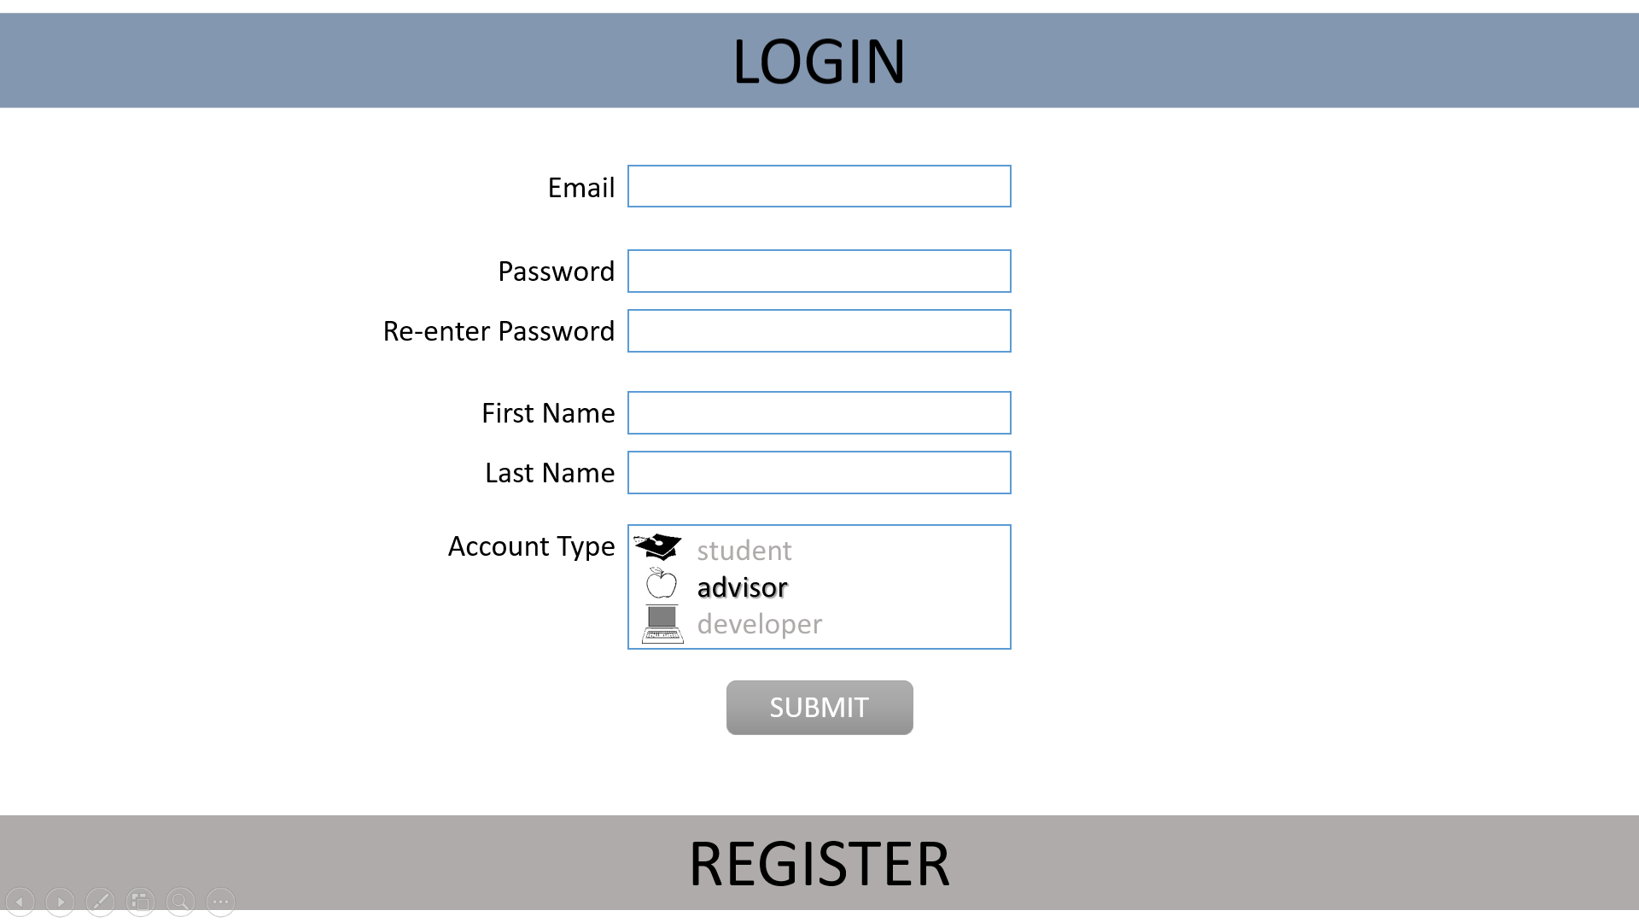
Registration
Notes:
Email pw pw2 first last acct type

Slide 14
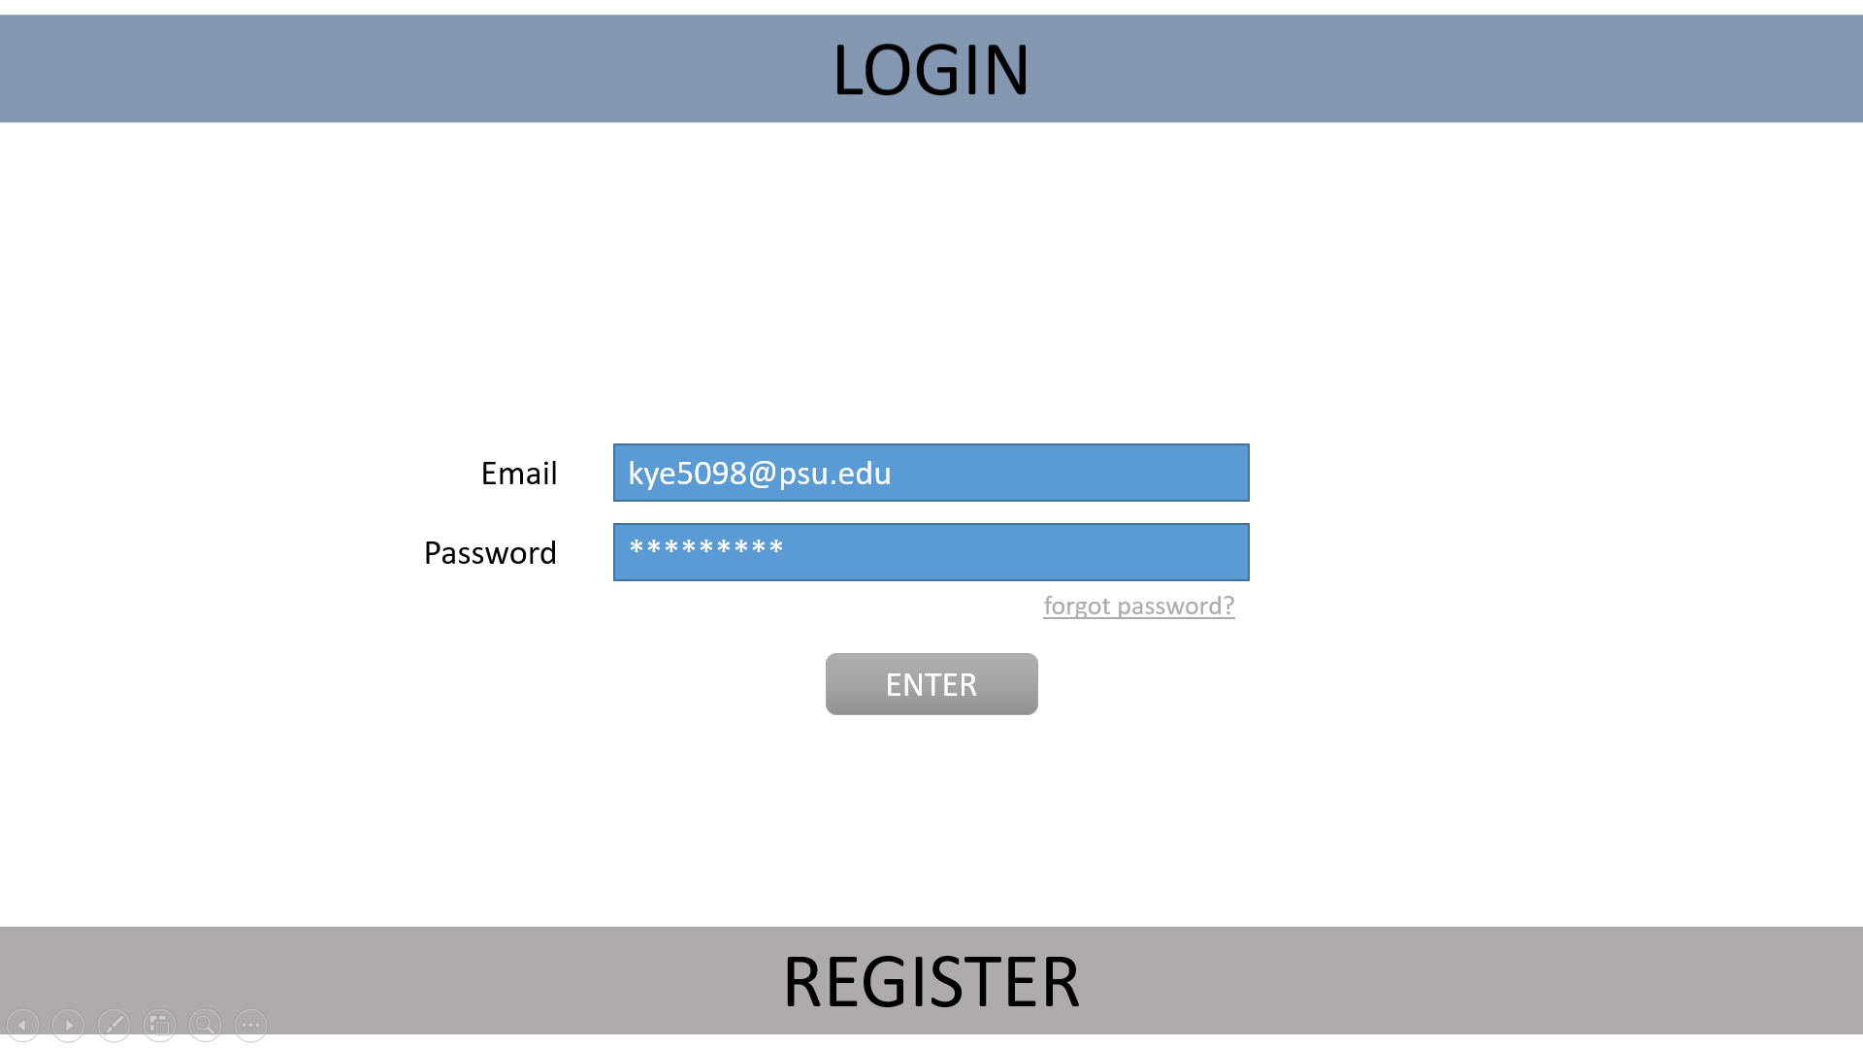
Login

Slide 15
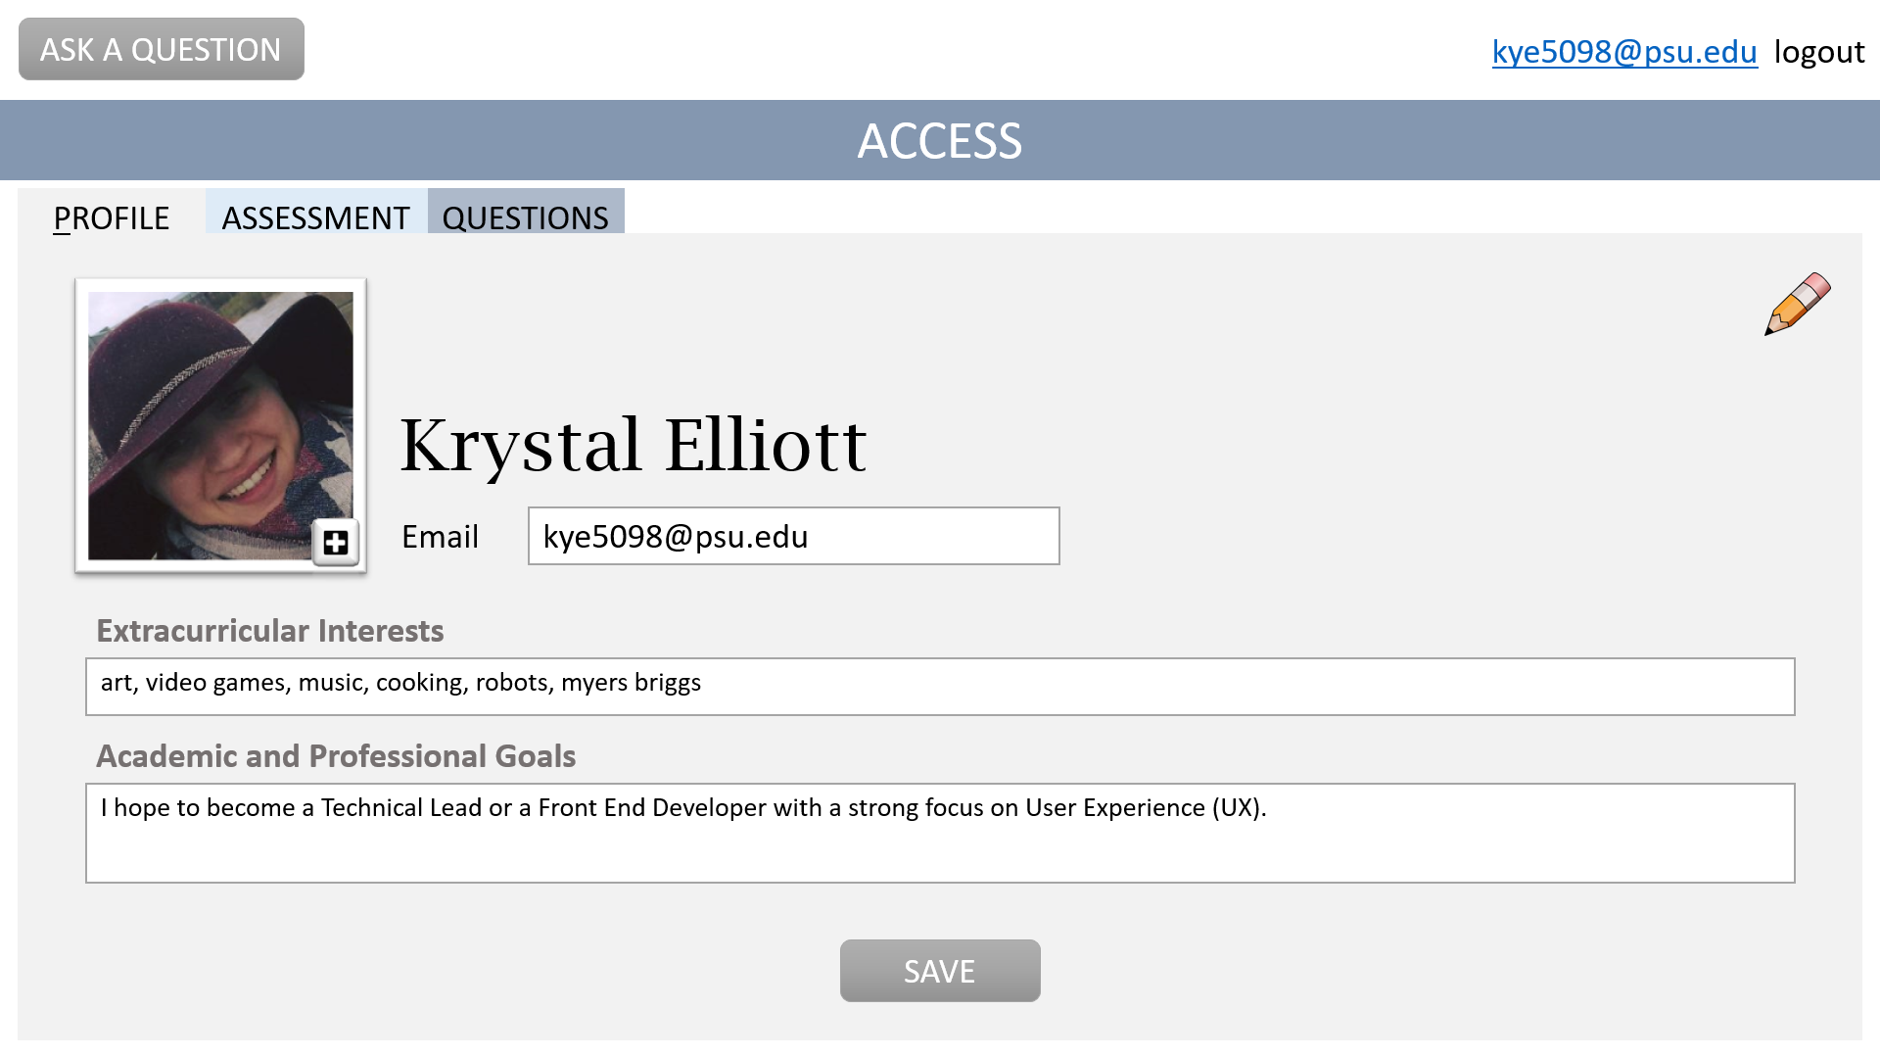
Access - Profile

Slide 16
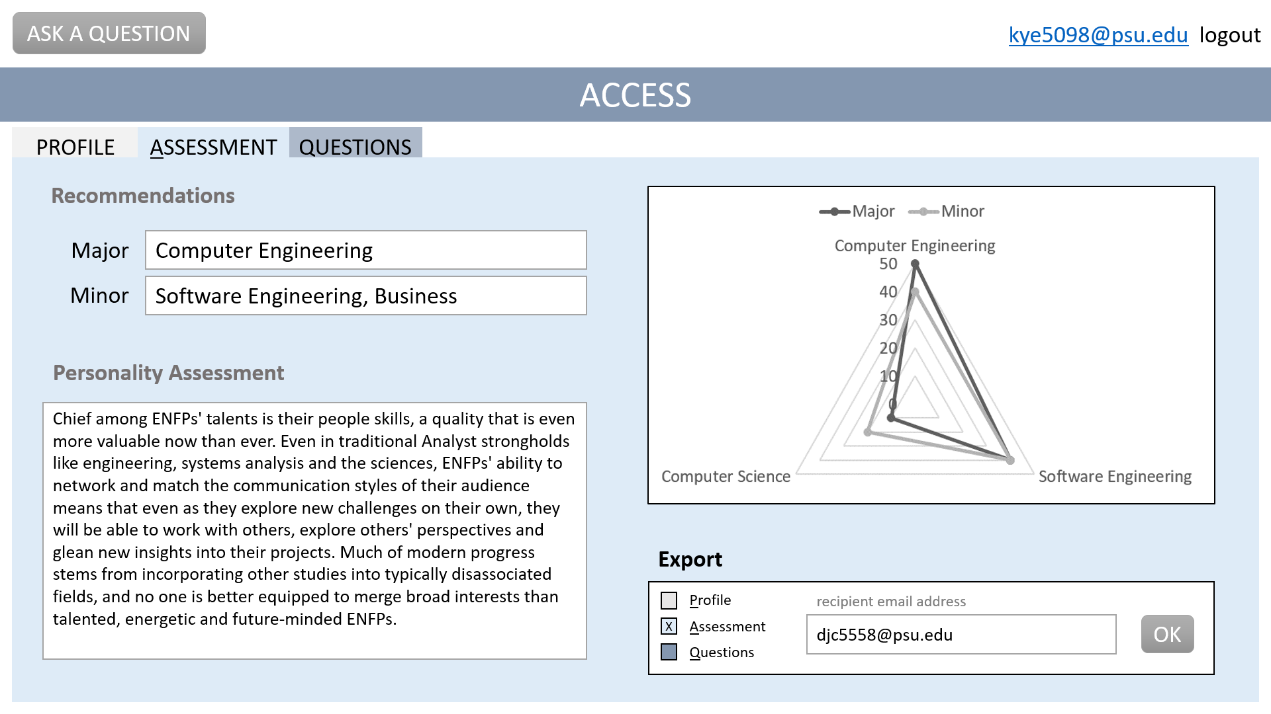
Access - Assessment

Slide 17
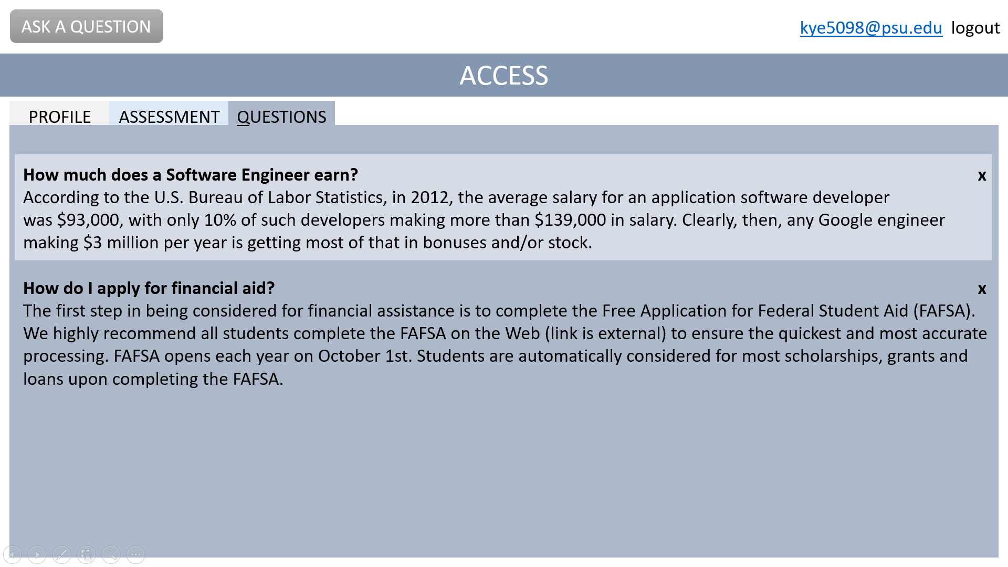
Access - Question Log

Slide 18
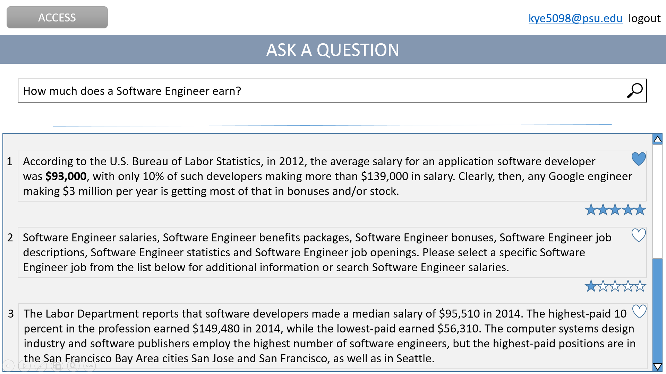
Search

Slide 19
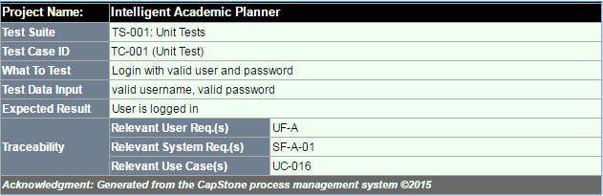
Test Cases - Login

Slide 20
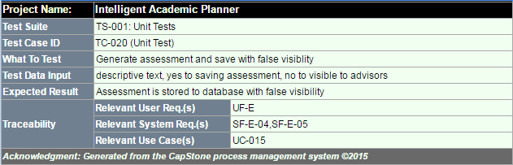
Test Cases - Generate Assessment

Slide 21
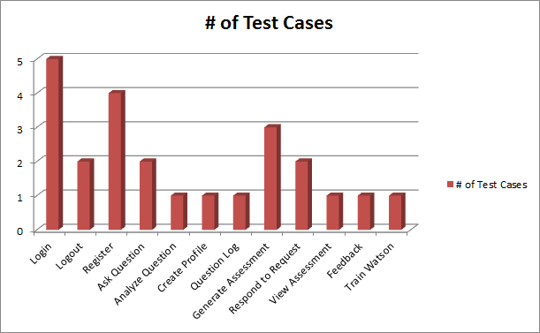
Test Cases
All requirements have at least one test case
A total of 24 unit test cases created

Slide 22
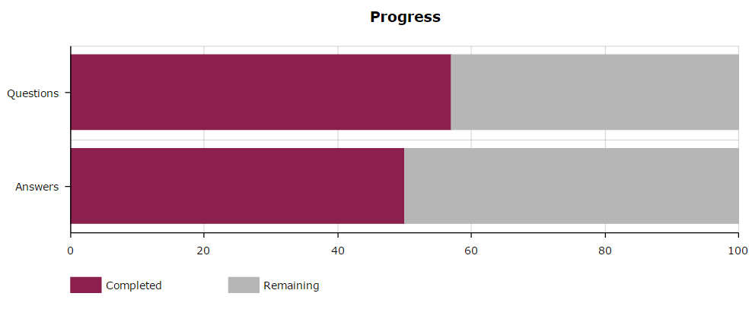

Question Progress
701/1000
570/1000
550/1000
685/1000
Notes:
120 Questions/wk

Slide 23

Questions & Answers
What is Penn State Behrend's tuition? Expensive, like any other tuition. But, to give you numbers… If you are currently living in Pennsylvania, the cost of tuition is approximately $6,934 per semester. If you are not in Pennsylvania, the cost of tuition is approximately $10,937 per semester. But don’t forget about rent, food, or books which are another $6,535 per semester if living on-campus!
Which jobs are available for a Computer Engineer?
Computer engineers can work for computer companies such as Intel, HP, and Texas Instruments, and also in industries that build or use computer-based systems, such as telecommunications, automotive, aerospace, etc. Many computer engineers also get jobs as programmers.
What types of classes does a Computer Engineering student take?
Computer engineers use practices from both computer science and electrical engineering to make computers faster and more compact. Usually as a computer engineer, you will be asked to design computer equipment (processors, routers, circuit boards), test and analyze computer hardware, modify hardware to accommodate new software, and possibly work with the software itself (designing, testing, instructing programmers how to write the code). While computer engineers have less programming experience than computer science graduates, their understanding of hardware gives them an advantage in dealing with overall systems.

Slide 24

Current System
Watson: Bluemix and Watson Developer Cloud
Server: Node.JS version 6
MongoDB: mLab
Client: Web Browser

Slide 25
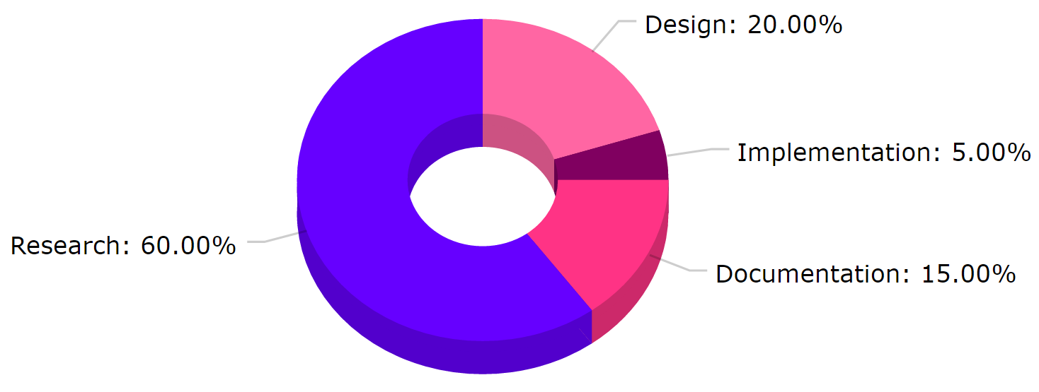
Conclusion
FALL 2016
Documentation: Report 2.0, Presentation 2
Design: System Architecture, User Interface
Implementation: Registration, Login, Ask Question
Research: Questions, Answers, Technology

Slide 26
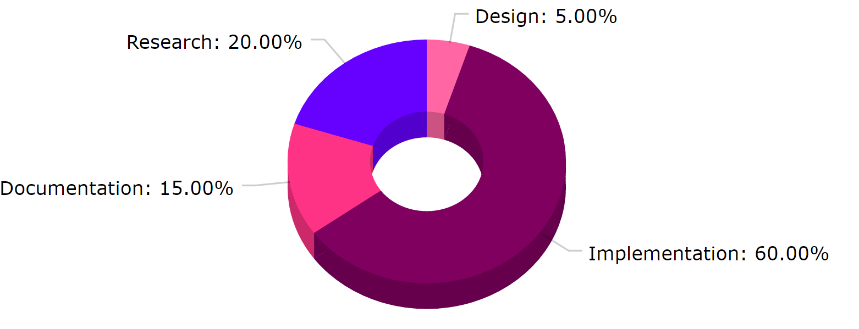
Conclusion
SPRING 2017
Documentation: Maintain/Update Report
Design: System Architecture, User Interface
Implementation: User Profile, Train Watson
Research: Technology

Slide 27


